Slide 1
Database Systems Relational Algebra
(Chapter 4, 4.1-4.2)

Slide 2
Relational Query Languages
Query languages (QL): Allow manipulation and retrieval of data from a database.
Relational model supports simple, powerful QLs:
Strong formal foundation based on logic.
Allows for much optimization.
Query Languages != programming languages!
QLs not expected to be “Turing complete”.
QLs not intended to be used for complex calculations.
QLs support easy, efficient access to large data sets.

Slide 3
Turing completeness
A system of data-manipulation rules (e.g. a computer's instruction set, a programming language, or a cellular automaton) is said to be Turing Complete or computationally universal if it can be used to simulate any single-taped Turing machine.

Slide 4
Formal Relational Query Languages
Two mathematical Query Languages form the basis for “real” languages (e.g. SQL), and for implementation:
Relational Algebra: More operational, very useful for representing execution plans.
Relational Calculus: Let users describe what they want, rather than how to compute it. (Non-procedural, declarative.)

Slide 5
Preliminaries
A query is applied to relation instances, and the result of a query is also a relation instance.
Schemas of input relations for a query are fixed (but query will run over any legal instance)
The schema for the result of a given query is also fixed. It is determined by the definitions of the query language constructs.
Positional vs. named-field notation:
Positional notation easier for formal definitions, named-field notation more readable.
Both used in SQL
Though positional notation is not encouraged

Slide 6
Relational Algebra: 5 Basic Operations
Selection ( σ ) Selects a subset of rows from relation (horizontal).
Projection ( π ) Retains only wanted columns from relation (vertical).
Cross-product ( × ) Allows us to combine two relations.
Set-difference ( — ) Tuples in r1, but not in r2.
Union ( ∪ ) Tuples in r1 and/or in r2.
Since each operation returns a relation, operations can be composed!
(Algebra is “closed”; e.g., x is closed wrt to the field of integer, but not /)

Slide 7
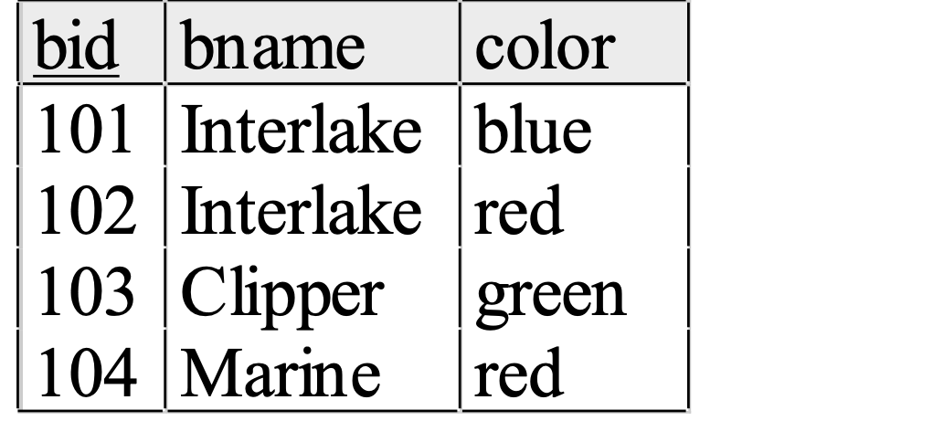
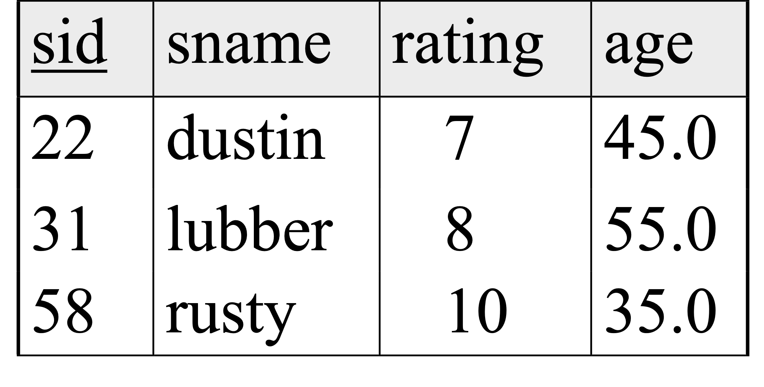
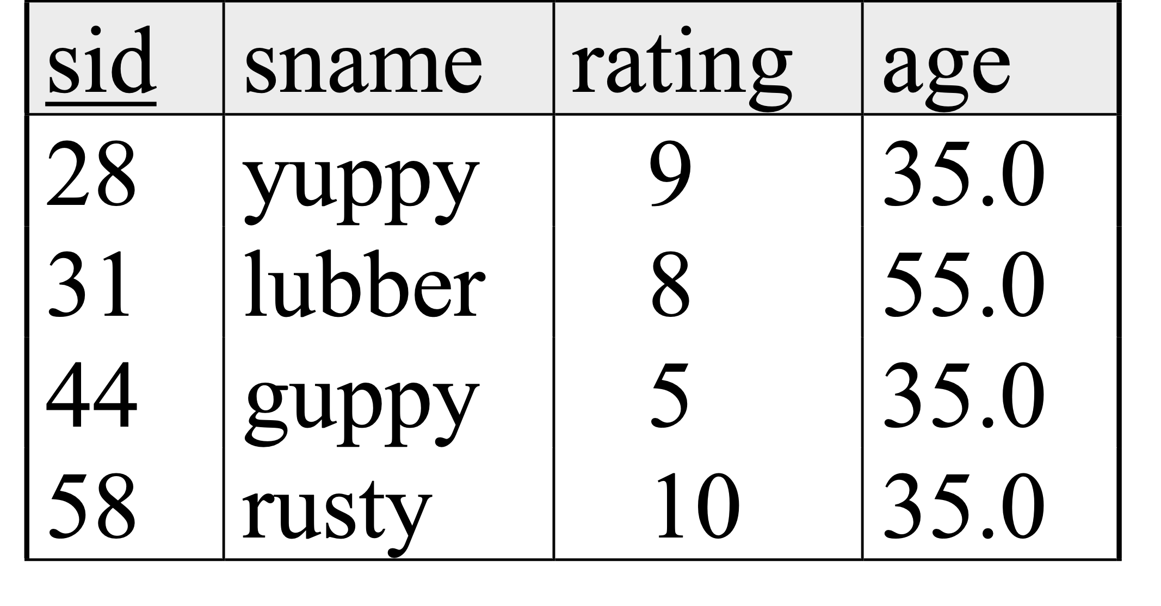
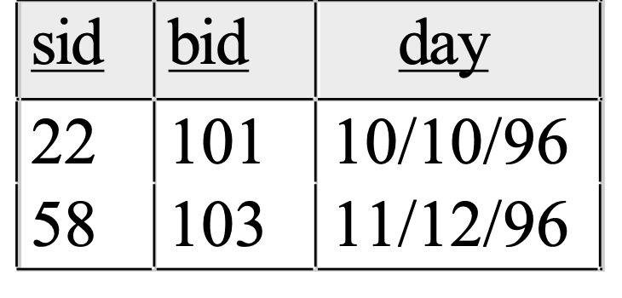
Example Instances
Sailors: S1
Boats
Sailors: S2
Reserve: R1

Slide 8
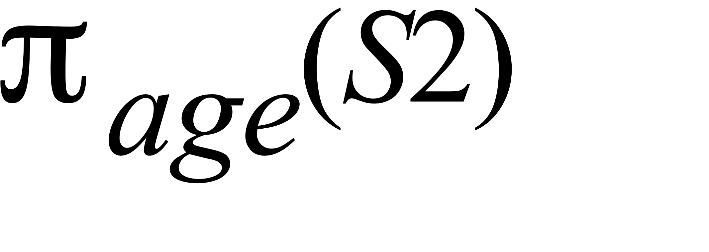
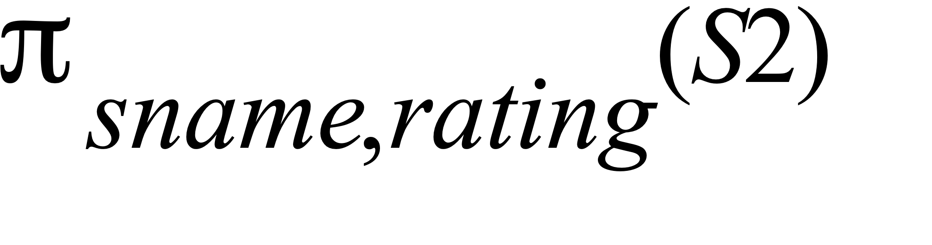
Projection
Examples:
Retains only attributes that are in the “projection list”.
Schema of result:
exactly the fields in the projection list, with the same names that they had in the input relation.
Projection operator has to eliminate duplicates
(How do they arise? Why remove them?)
Note: real systems typically don’t do duplicate elimination unless the user explicitly asks for it. (Why not?)

Slide 9
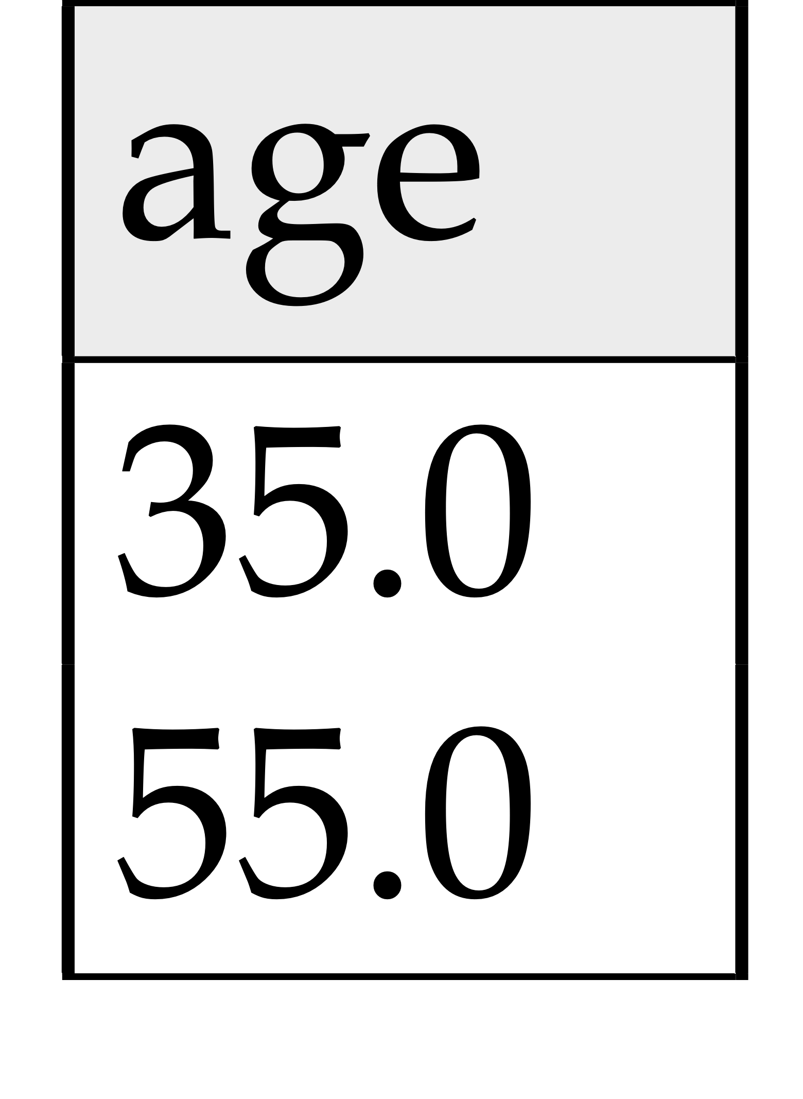
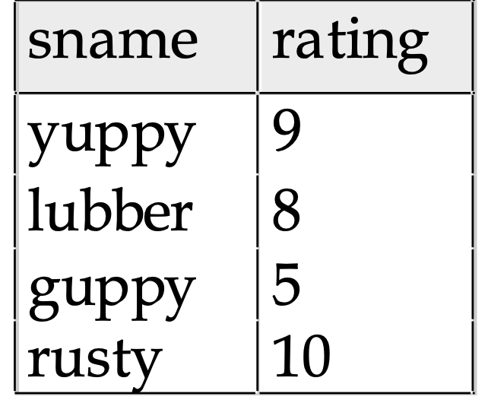
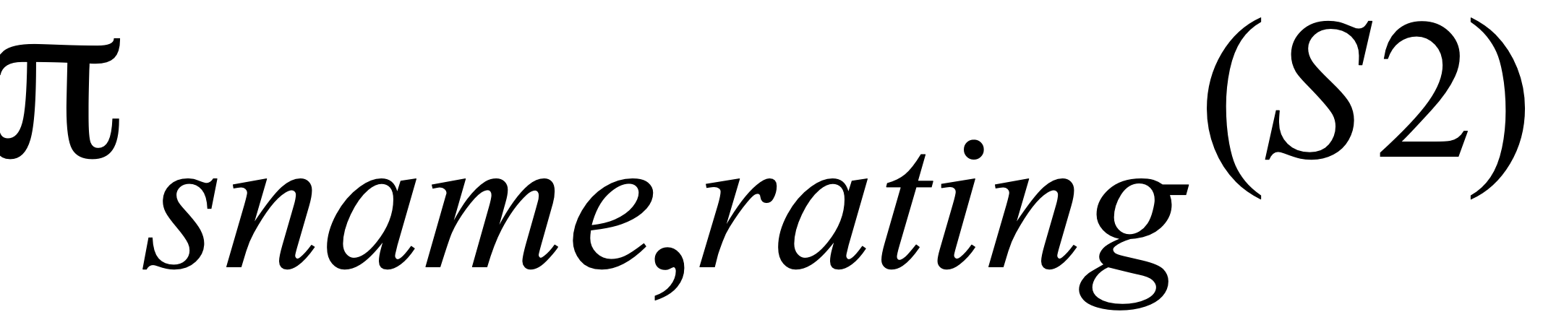
Projection
S2

Slide 10
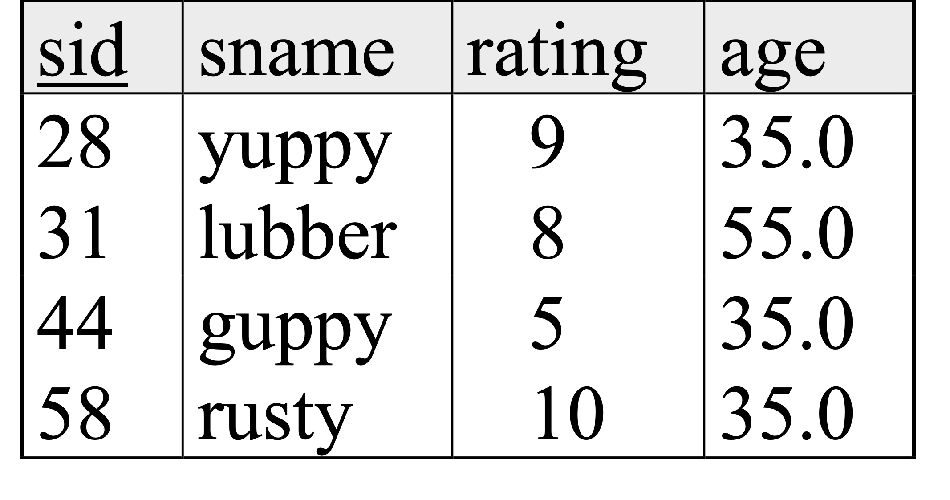
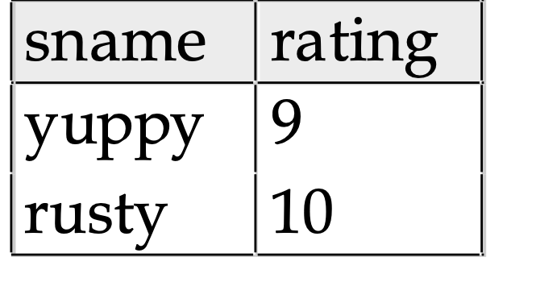
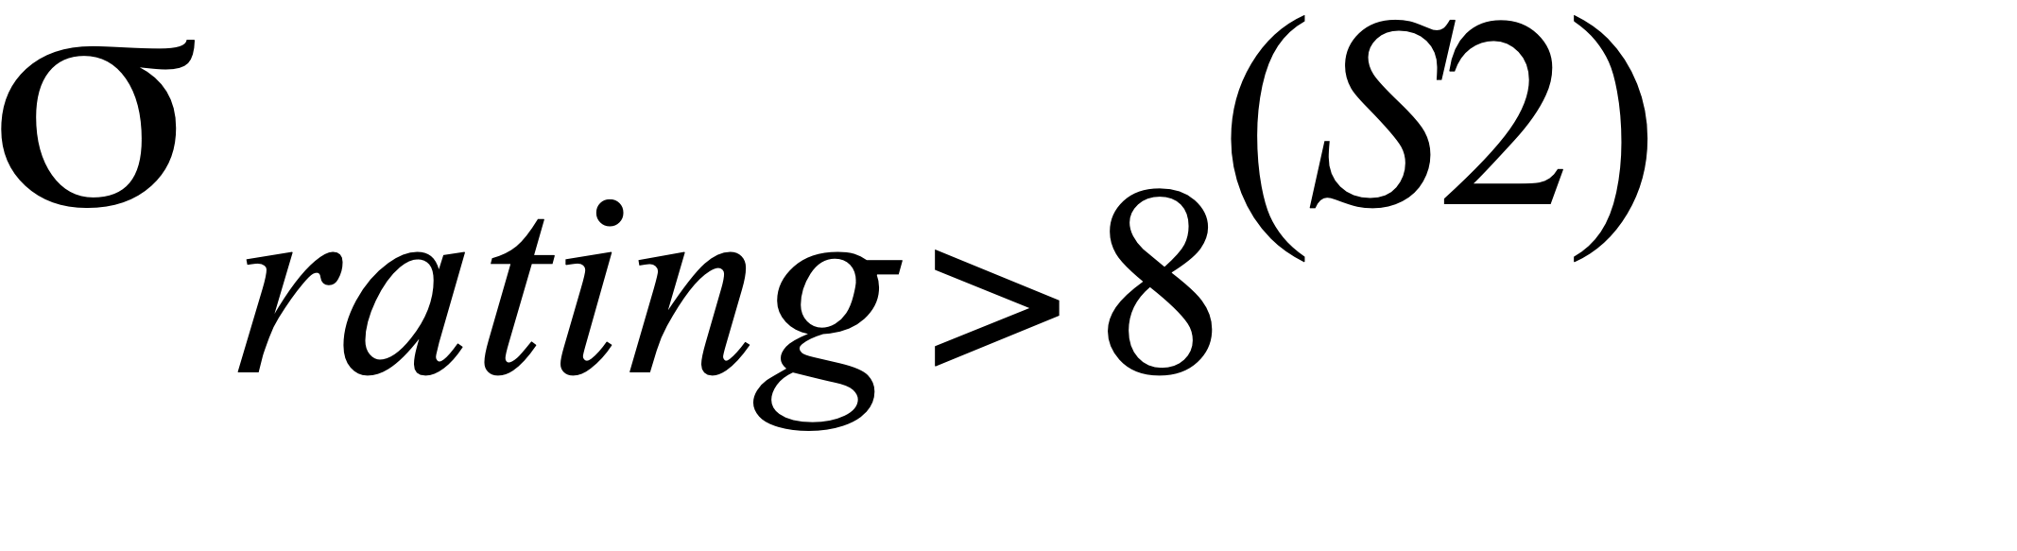
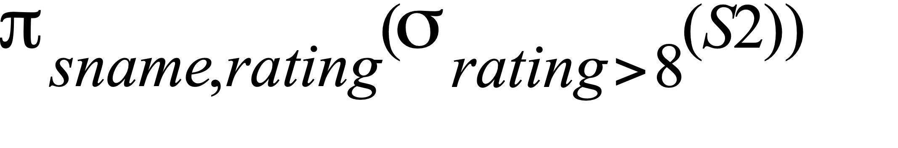
Selection (σ)
Selects rows that satisfy selection condition.
Result is a relation.
Schema of result is same as that of the input relation.
Do we need to do duplicate elimination?

Slide 11
Union and Set-Difference
All of these operations take two input relations, which must be union-compatible:
Same number of fields.
`Corresponding’ fields have the same type.
For which, if any, is duplicate elimination required?

Slide 12
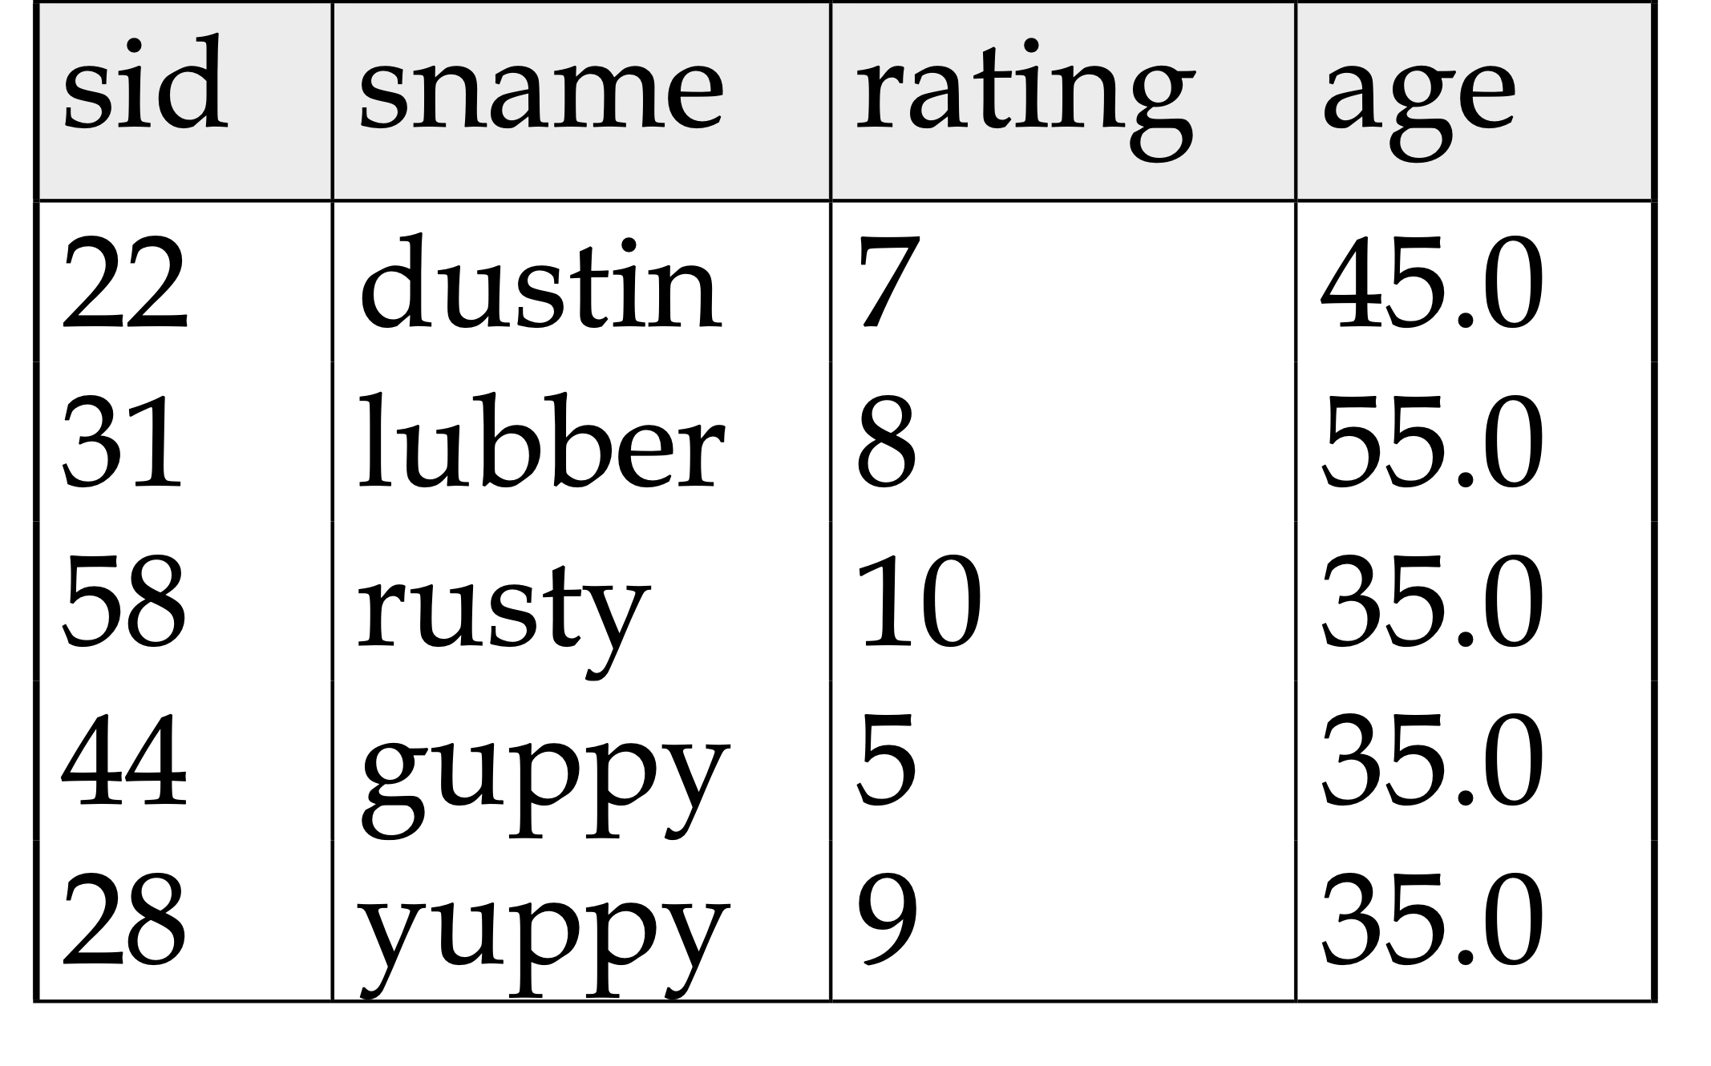

Union
S1
S2

Slide 13
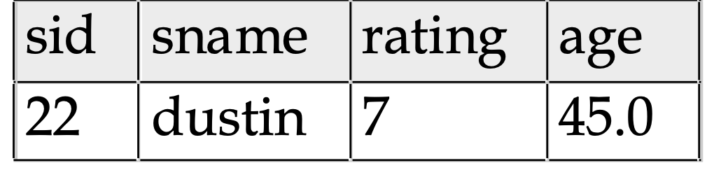

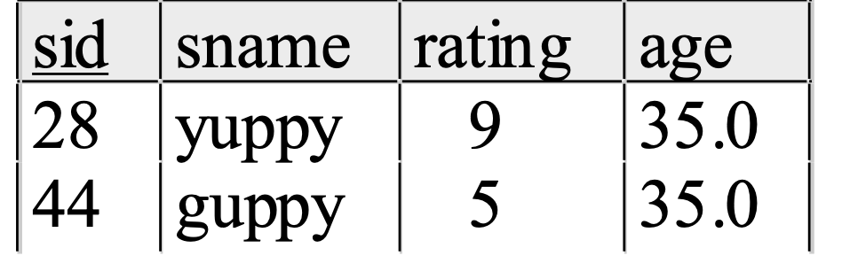
Set Difference
S1
S2 – S1
S2

Slide 14
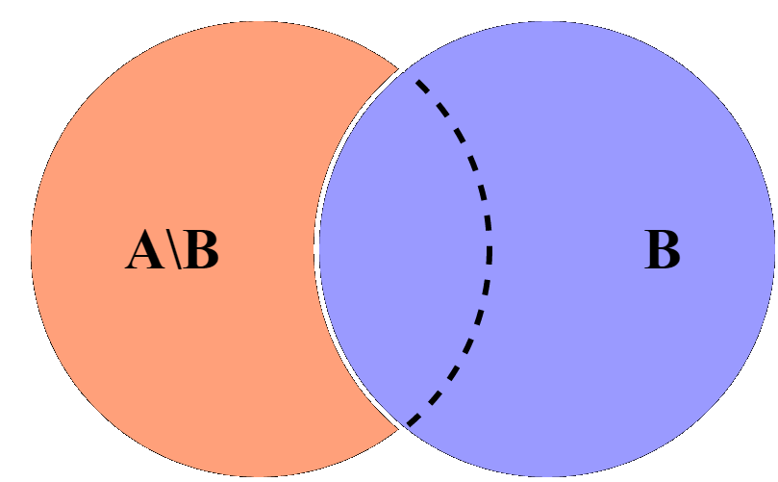
Illustration
A Ո B
A

Slide 15
Cross-Product (Cartesian product)
S1 × R1: Each row of S1 paired with each row of R1.
Q: How many rows in the result?
Result schema has one field per field of S1 and R1, with field names `inherited’ if possible.
May have a naming conflict: Both S1 and R1 have a field with the same name.
In this case, we can use the renaming operator:

Slide 16
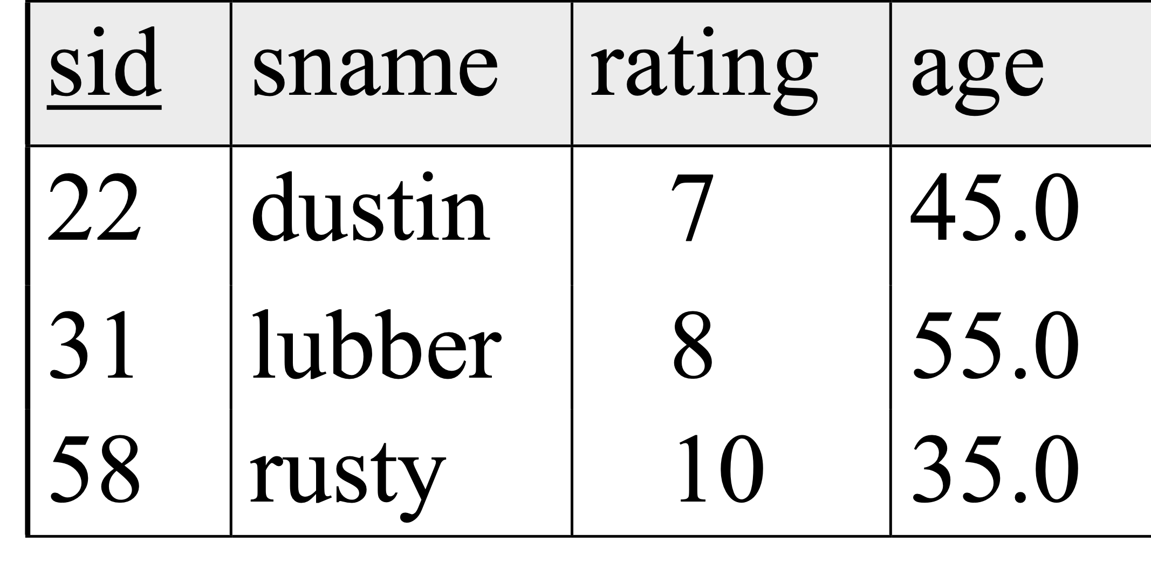
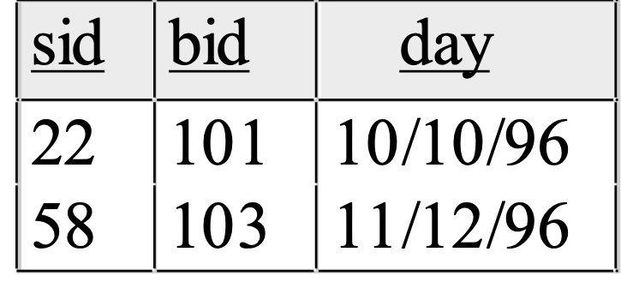
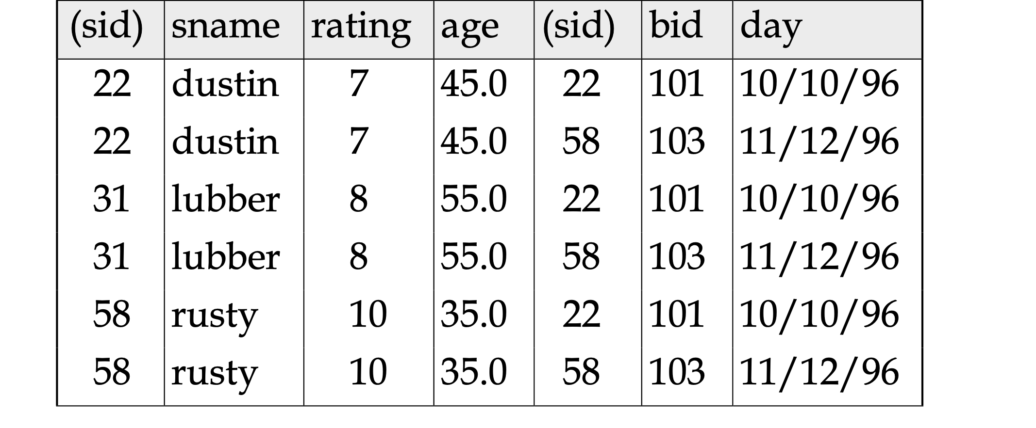
Cross Product Example
R1
S1
S1 X R1 =

Slide 17
Compound Operator: Intersection
In addition to the 5 basic operators, there are several additional “Compound Operators”
These add no computational power to the language, but are useful shorthand.
Can be expressed solely with the basic ops.
Intersection takes two input relations, which must be union-compatible.
Q: How to express it using basic operators? R ∩ S
R ∩ S = R − (R − S)

Slide 18
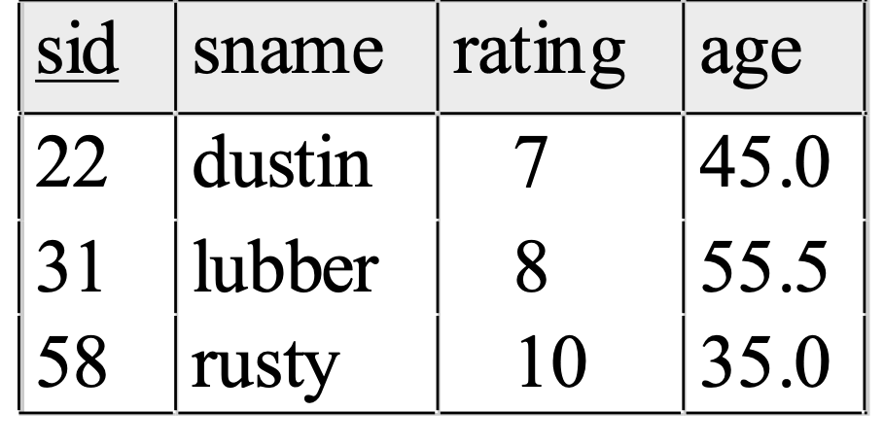
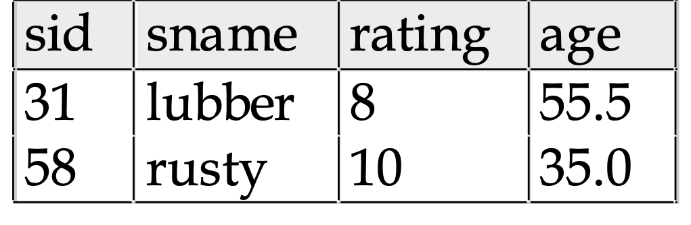
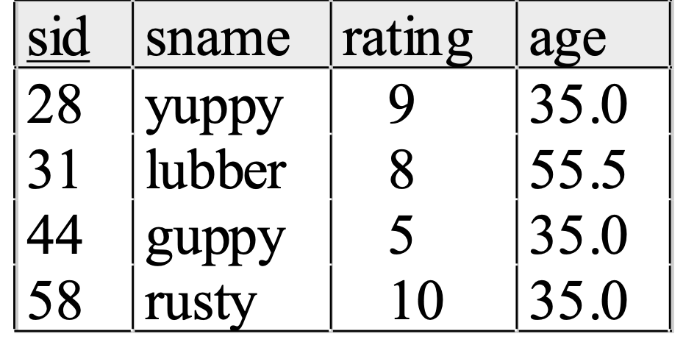

Intersection
S1
S2

Slide 19
Compound Operator: Join
Joins are compound operators involving cross product, selection, and (sometimes) projection.
Most common type of join is a “natural join” (often just called “join”).
R S conceptually is:
Compute R × S
Select rows where attributes that appear in both relations have equal values
Project all unique attributes and one copy of each of the common ones.
Note: Usually done much more efficiently than this.
Useful for putting “normalized” relations back together (normalization is the process of breaking an input schema into a set of smaller schemas in order to reduce redundancy in the database).
if the common column is not key, we will have dublicates.

Slide 20
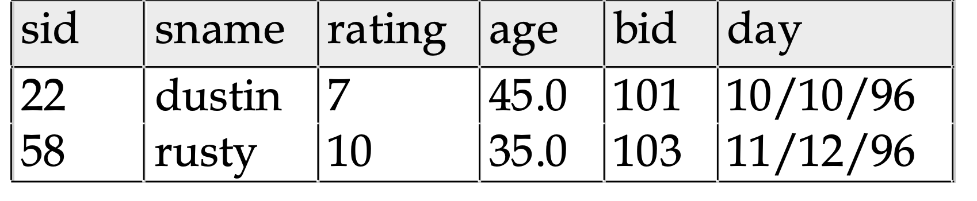
Natural Join Example
R1
S1
S1 R1 =

Slide 21
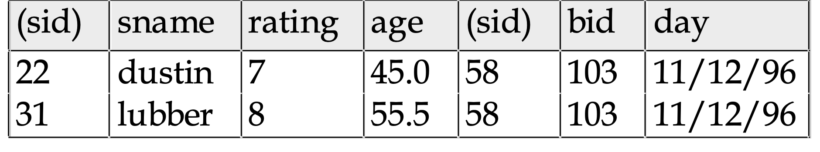
Other Types of Joins
Condition Join (or “theta-join”):
R ⋈c S = σc (R x S)
Example: S1 ⋈S1.sid<R1.sid R1
Result schema same as that of cross-product.
May have fewer tuples than cross-product.
Equi-Join: Special case: condition c contains only conjunction of equalities.

Slide 22
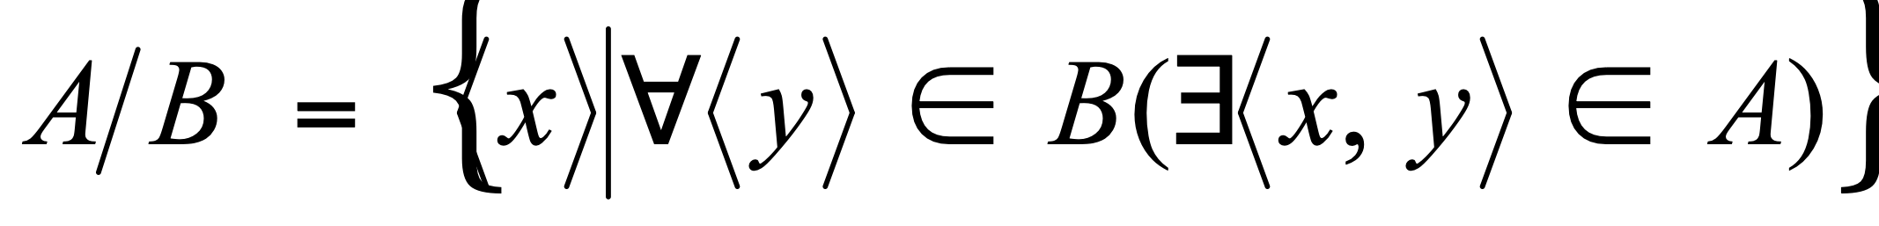
Compound Operator: Division
Useful for expressing “for all” queries like: Find sids of sailors who have reserved all boats.
For A/B attributes of B are subset of attributes of A.
May need to “project” to make this happen.
E.g., let A have 2 fields, x and y; B have only field y:
A/B contains all tuples (x) such that for every y tuple in B, there is an xy tuple in A.
The schema of A/B is those attributes in A but not in B.

Slide 23
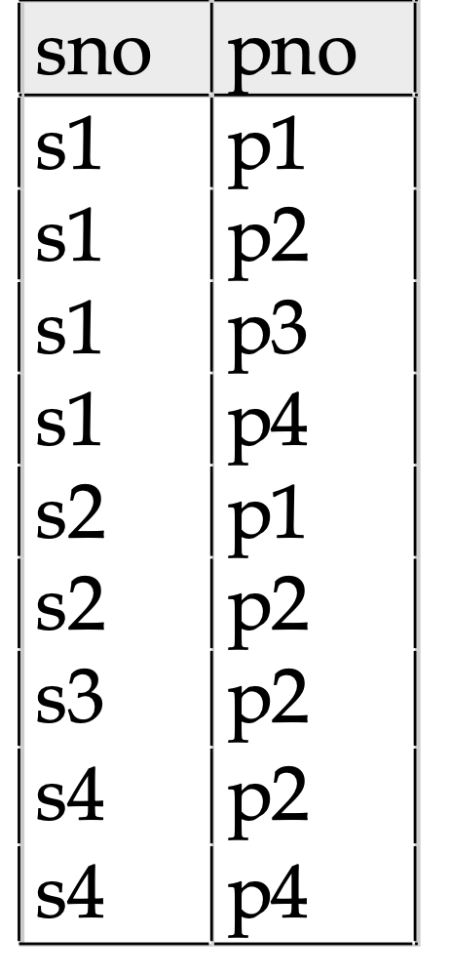
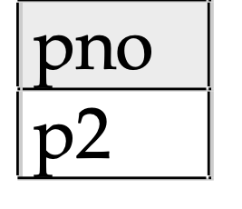
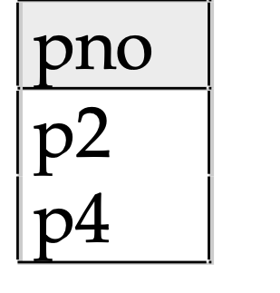
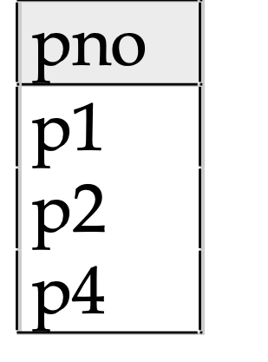
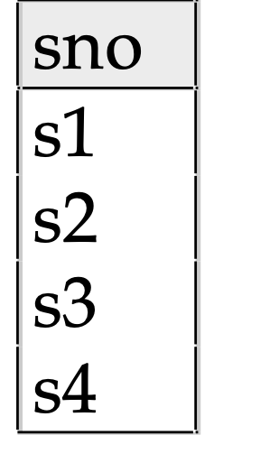
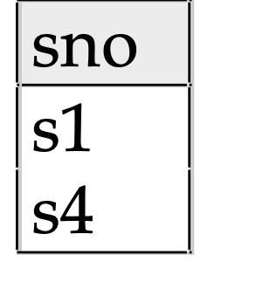
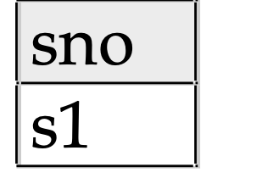
Examples of Division A/B
B1
B2
B3
A
A/B1
A/B2
A/B3

Slide 24
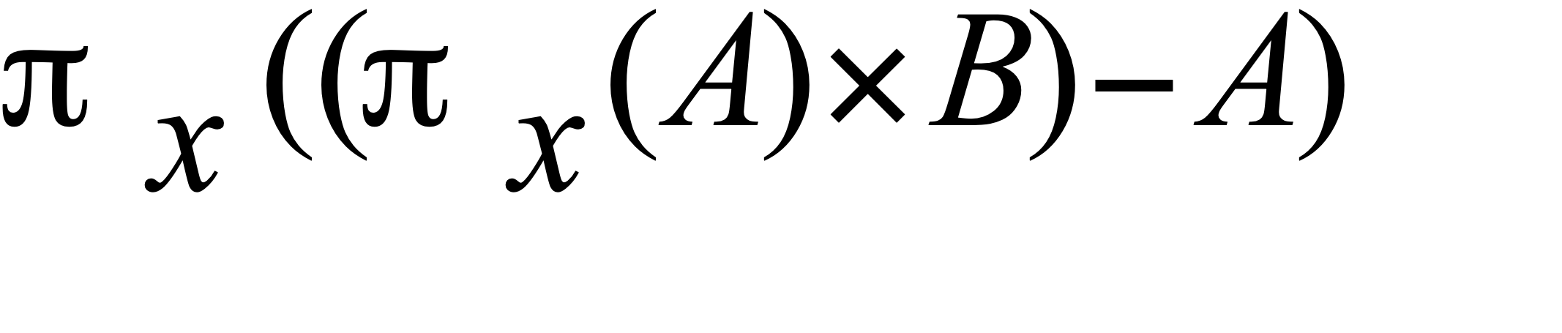
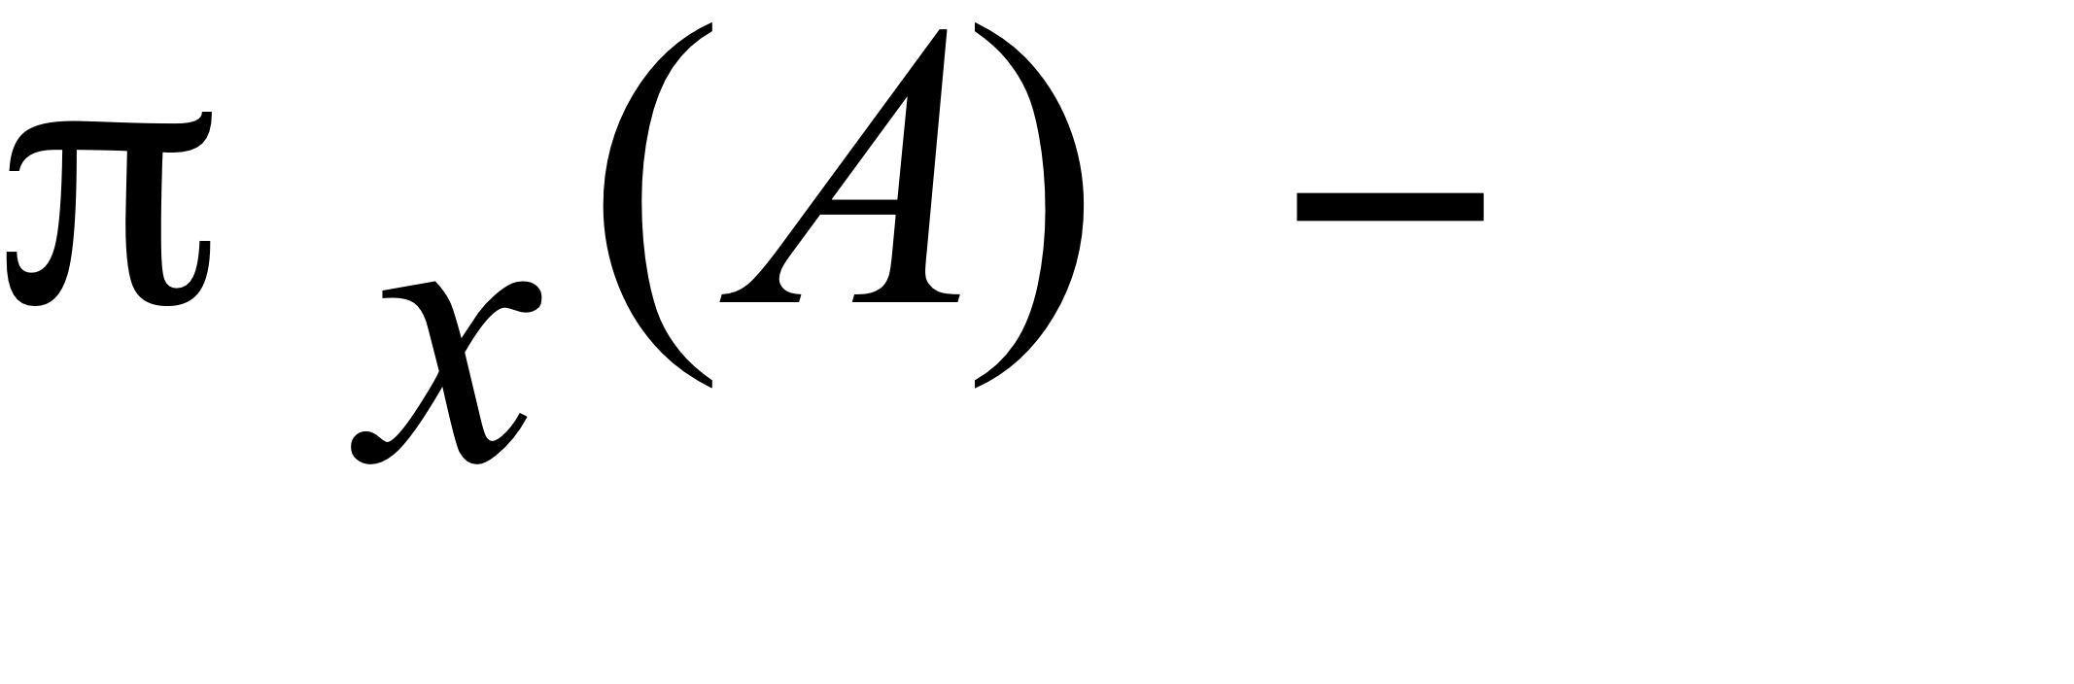
Expressing A/B Using Basic Operators
Division is not essential op; just a useful shorthand.
(Also true of joins, but joins are so common that systems implement joins specially.)
Idea: For A(x,y)/B(y), compute all x values that are not `disqualified’ by some y value in B.
x value is disqualified if by attaching y value from B, we obtain an xy tuple that is not in A.
Disqualified x values:
A/B:
Disqualified x values

Slide 25

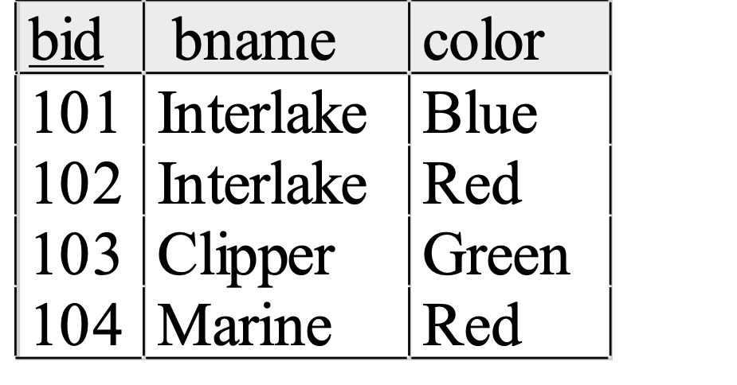
Examples
Reserves
Sailors
Boats

Slide 26
Find names of sailors who’ve reserved boat #103
Solution 1: πsname ((σbid=103 Reserves) ⋈ Sailors)
Solution 2: πsname (σbid=103 (Reserves ⋈ Sailors))

Slide 27
Find names of sailors who’ve reserved a red boat
Information about boat color only available in Boats; so need an extra join:
πsname ((σcolor=‘red’ Boats) ⋈Reserves) ⋈ Sailors)
A more efficient solution:
πsname (πsid(πbid(σcolor=‘red’ Boats) ⋈Reserves) ⋈ Sailors)
A query optimizer can find this given the first solution!

Slide 28
Find sailors who’ve reserved a red or a green boat
Can identify all red or green boats, then find sailors who’ve reserved one of these boats:
ρ(Tempboats, (σcolor=‘red’ OR color = ‘green’ Boats))
πsname ( Tempboats ⋈ Reserves ⋈ Sailors)

Slide 29
Find sailors who’ve reserved a red and a green boat
Previous approach won’t work! Must identify sailors who’ve reserved red boats, sailors who’ve reserved green boats, then find the intersection (note that sid is a key for Sailors):
ρ(Tempred, πsid ((σcolor=‘red’ Boats) ⋈ Reserves)
ρ(Tempgreen, πsid ((σcolor=‘green’ Boats) ⋈ Reserves)
πsname((Tempred ∩ Tempgreen) ⋈ Sailors)

Slide 30
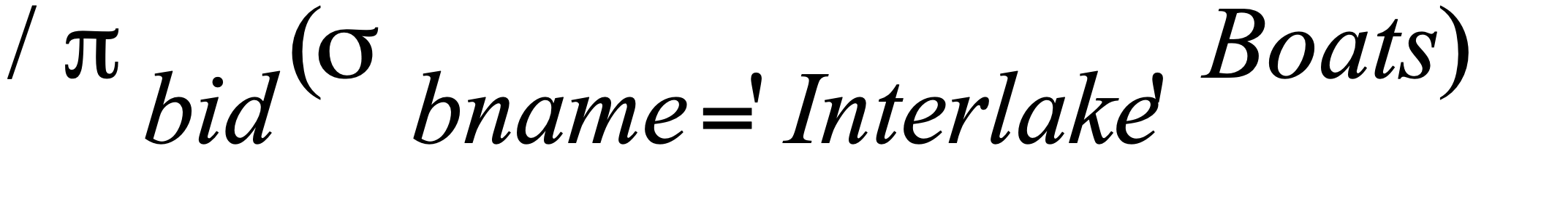
Find the names of sailors who’ve reserved all boats
Uses division; schemas of the input relations to / must be carefully chosen:
ρ(Tempsids, (πsid,bid Reserves)/(πbid Boats) )
πsname(Tempsids ⋈ Sailors)
To find sailors who’ve reserved all ‘Interlake’ boats:
.....

Slide 31
Find the names of sailors who have reserved at least two boats
ρ(Reservations, πsid,sname,bid (Sailors ⋈ Reserves)
ρ(Respairs(1->sid1, 2->sname1, 3->bid1, 4->sid2, 5->sname2,
6->bid2), Reservations X Reservations )
π sname (σ sid1 = sid2 AND bid1 <> bid2 Respairs)
Note: <> means ≠

Slide 32
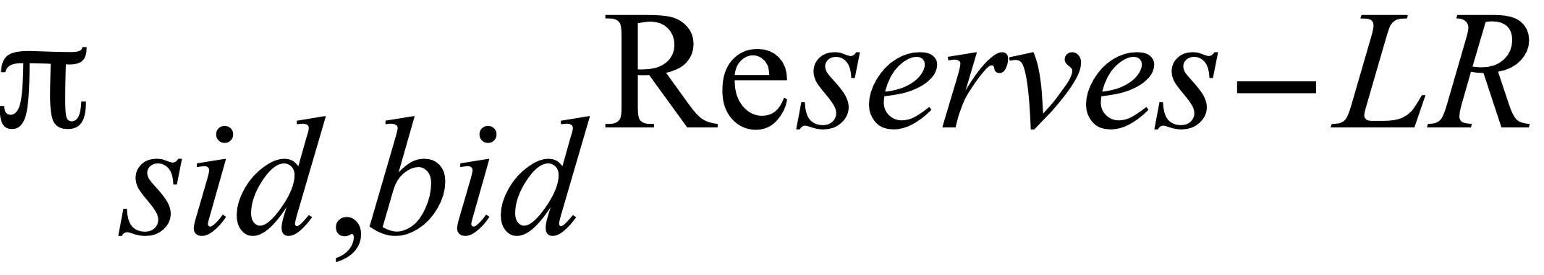
For each boat, find the sailor with the smallest sailor id who has reserved this boat
ρ(R1(sid1, bid1), πsid,bid Reserves)
ρ(R2(sid2, bid2), πsid,bid Reserves)
ρ(LR(sid, bid), πsid1,bid1 (R1 ⋈ bid1=bid2 AND sid1>sid2 R2)

Slide 33

For each boat, find the sailor(s) with the largest rating who has reserved this boat
ρ(R1(sid1, bid1, r1), πsid,bid,rating (Reserves ⋈ Sailors)
ρ(R2(sid2, bid2, r2), πsid,bid,rating (Reserves ⋈ Sailors)
ρ(SR(sid, bid,r), πsid1,bid1,r1 (R1 ⋈ bid1=bid2 AND sid1 <> sid2 AND r1 < r2 R2)

Slide 34
Summary
Relational Algebra: a small set of operators mapping relations to relations
Operational, in the sense that you specify the explicit order of operations
A closed set of operators! Can mix and match.
Basic ops include: σ, π, ×, ∪, —
Important compound ops: ∩, /,

Slide 35
Multisets (bags)

Slide 36
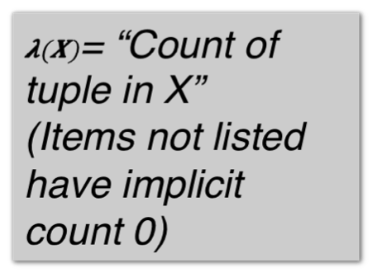
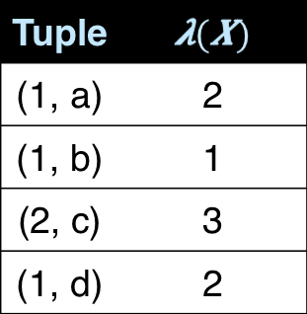
SQL uses Multisets
Multiset X
Tuple
(1, a)
(1, a)
(1, b)
(2, c)
(2, c)
(2, c)
(1, d)
(1, d)
Multiset X
Equivalent Representations of a Multiset
Note: In a set all counts are {0,1}.

Slide 37
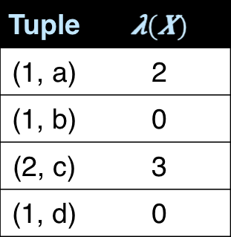
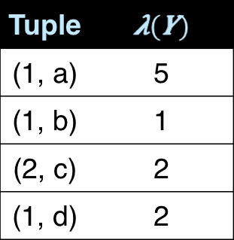


Generalizing Set Operations to Multiset Operations
Multiset X
Multiset Y
Multiset Z
∩
For sets, this is intersection

Slide 38


Generalizing Set Operations to Multiset Operations
Multiset X
Multiset Y
Multiset Z
∪
For sets,
this is union
38

Slide 39
Operations on Multisets (bags)
All RA operations need to be defined carefully on bags
s_{C}(R): preserve the number of occurrences
Π_{A}(R): no duplicate elimination
Cross-product, join: no duplicate elimination
This is important- relational engines work on multisets, not sets!

Slide 40
RA has Limitations !
Cannot compute “transitive closure”
Find all direct and indirect relatives of Fred
Cannot express in RA !!!
Need to write Java program, use a graph engine, or modern SQL…
Name1 | Name2 | Relationship
Fred | Mary | Father
Mary | Joe | Cousin
Mary | Bill | Spouse
Nancy | Lou | Sister

